Slide 1
Data Race Detection
Assaf Schuster

Slide 2
What is a Data Race?
Two concurrent accesses to a shared location, at least one of them for writing.
  Result non-deterministic
  For some memory models result is undefined
  Strong indication of a bug
Thread 1 Thread 2
X++ T=Y
Z=2 X++
LOAD X
ADD X,1
STORE X

Slide 3
How Can Data Races be Prevented?
Explicit synchronization between threads:
  Locks
  Critical Sections
  Barriers
  Mutexes
  Semaphores
  Monitors
  Events
  Etc.
Thread 1 Thread 2
Lock(m)
X++
Unlock(m)
Lock(m)
X++
Unlock(m)

Slide 4
Is This Sufficient?
Yes!
No!
  Programmer dependent
    Correctness – programmer may forget to synch
      Need tools to detect data races
  Expensive
    Efficiency – to achieve correctness, programmer may overdo.
      Need tools to remove excessive synch’s

Slide 5
Where is Waldo?
#define N 100
Type g_stack = new Type[N];
int g_counter = 0;
Lock g_lock;
void push( Type& obj ){lock(g_lock);...unlock(g_lock);}
void pop( Type& obj ) {lock(g_lock);...unlock(g_lock);}
void popAll( ) {
lock(g_lock);
delete[] g_stack;
g_stack = new Type[N];
g_counter = 0;
unlock(g_lock);
}
int find( Type& obj, int number ) {
lock(g_lock);
for (int i = 0; i < number; i++)
if (obj == g_stack[i]) break; // Found!!!
if (i == number) i = -1; // Not found… Return -1 to caller
unlock(g_lock);
return i;
}
int find( Type& obj ) {
return find( obj, g_counter );
}

Slide 6
Can You Find the Race?
#define N 100
Type g_stack = new Type[N];
int g_counter = 0;
Lock g_lock;
void push( Type& obj ){lock(g_lock);...unlock(g_lock);}
void pop( Type& obj ) {lock(g_lock);...unlock(g_lock);}
void popAll( ) {
lock(g_lock);
delete[] g_stack;
g_stack = new Type[N];
g_counter = 0;
unlock(g_lock);
}
int find( Type& obj, int number ) {
lock(g_lock);
for (int i = 0; i < number; i++)
if (obj == g_stack[i]) break; // Found!!!
if (i == number) i = -1; // Not found… Return -1 to caller
unlock(g_lock);
return i;
}
int find( Type& obj ) {
return find( obj, g_counter );
}
Similar problem was found
in java.util.Vector
write
read

Slide 7
Detecting Data Races?
NP-hard [Netzer&Miller 1990]
  Input size = # instructions performed
  Even for 3 threads only
  Even with no loops/recursion
Execution orders/scheduling (#threads)^{thread_length}
# inputs
Detection-code side-effects
Weak memory, instruction reorder, atomicity...

Slide 8
Apparent Data Races
Based only on the behavior of the explicit synch
  not on program semantics
Easier to detect
Less accurate (false negatives/positives).
Example:
Initially: grades = oldDatabase; updated = false;
Thread T.A.
grades = newDatabase;
updated = true;
Thread Lecturer
while (updated == false);
X:=grades.gradeOf(lecturersSon);

Slide 9
Detection Approaches
Restricted pgming model
  Usually fork-join
Static
  Emrath, Padua 88
  Balasundaram, Kenedy 89
  Mellor-Crummy 93
  Flanagan, Freund 01
Postmortem
  Netzer, Miller 90, 91
  Adve, Hill 91
On-the-fly
  Dinning, Schonberg 90, 91
  Savage et.al. 97
  Itskovitz et.al. 99
  Perkovic, Keleher 00
  Choi 02
Issues:
pgming model
synch’ method
memory model
accuracy
overhead
granularity
coverage
fork
fork
join
join

Slide 10
MultiRace Approach
On-the-fly detection of apparent data races
Two detection algorithms (improved versions)
  Lockset [Savage, Burrows, Nelson, Sobalvarro, Anderson 97]
  Djit⁺ [Itzkovitz, Schuster, Zeev-ben-Mordechai 99]
    Correct even for weak memory systems ☺
Flexible detection granularity
  Variables and Objects
  Especially suited for OO programming languages
Source-code (C++) instrumentation + Memory mappings
  Transparent ☺
  Low overhead ☺

Slide 11
Djit [Itskovitz et.al. 1999]
Apparent Data Races with Locks
Lamport’s happens-before partial order (send-receive ➔ unlock-lock)
a,b concurrent if neither a ^{hb}→ b nor b ^{hb}→ a
  ➔ Apparent data race
  Otherwise, they are “synchronized”
Djit basic idea: while running (“on-the-fly”) check each access performed against all previously logged accesses
Thread 1 | Thread 2
. a . Unlock(L) . . . | . . . . . Lock(L) . b
a ^{hb}→ b

Slide 12
Local Time Frames (LTF)
The execution of each thread is split into a sequence of time frames.
A new time frame starts on each unlock.
For every access there is a timestamp = a vector of LTFs known to the thread at the moment the access takes place
Thread | LTF
x = 1 lock( m1 ) z = 2 lock( m2 ) y = 3 unlock( m2 ) z = 4 unlock( m1 ) x = 5 | 1 1 1 2 3

Slide 13
Vector Time Frames
Thread 1 |  | Thread 2 |  | Thread 3
 | (1 1 1) |  | (1 1 1) |  | (1 1 1)
write X unlock( m1 ) read Z | (2 1 1) | lock( m1 ) read Y unlock( m2 ) write X | (2 1 1) (2 2 1) | lock( m2 ) write X | (2 2 1)

Slide 14
Time Stamps
From vector clocks lecture:
a ^{hb}→ b iff
a.LTF_{a}<b.timestamp[t_{a}]
In the example on the right timestamp(b)[t_{a}]=T_{sync}
LTF_{a} | t_{a} | t_{b}
T_{a} T_{unlock} T_{sync} | lock . a . unlock . unlock(m) . . . | . . . lock . . . . lock(m) . b

Slide 15
Checking for a Race
a and b are racing if:
a and b access same variable
and ( a.type = write ⋁ b.type = write )
and ( a.ltf ≥ b.timestamp[a.thread_id] ) not (a ^{hb}→b )
and ( b.ltf ≥ a.timestamp[b.thread_id] ) not (b ^{hb}→a )
Issues:
Too much storage (long timestamps)
Too many checks per access (all other accesses)

Slide 16
The access history log to a shared variable v
Log:
Program:
t_{c} | t_{a} | t_{b}
c lock | lock . a . unlock . unlock(m) . a’ a’’ | . . . lock . b . . lock(m) . b’
t_{c} | t_{a} | t_{b}
c’ lock | lock . a’’’ . unlock . | . b’’ . lock . b’’’ . .
Program
counter
Program
counter

Slide 17
Optimization 1:
Using Sequential Consistency of log
Suppose access a was logged earlier than b
  Then we know not (b ^{hb}→a ) … no need to check ☺
  Will not prove - implied by Sequential Consistency of log

Slide 18
Optimization 1:
Using Sequential Consistency of log
Suppose access a was logged earlier than b
  Then not (b ^{hb}→a ) … no need to check ☺
  Will not prove - implied by Sequential Consistency of log
Observation: for this check there is no need to store full vector timestamps ☺
  b’s full timestamp known at the time b happens
  only a.ltf logged and known at the time b happens
  It is left to check that
    a.ltf ≥ b.timestamp[a.thread_id] not (a ^{hb}→b )

Slide 19
Optimization 2:
Checking at most two accesses per variable per ltf
Let:
Access a by thread t₁
b and c by t₂ in same ltf
b precedes c by program order.
Then:
If a and b synchronized then a and c are synchronized too.
Thread 2 | Thread 1
lock( m ) write X read X unlock( m ) | lock( m ) write X write X unlock( m )
b
c
No check
no logging
It is sufficient to store and check only the first read access and the first write access to each variable in each ltf ☺
Algorithm finds a single race ☹
a
No check
no logging

Slide 20
… but have to check write after read
a by thread t₁
b and c by t₂ in same ltf
b precedes c by program order.
If a and b synchronized: a and c synchronized too.
Thread 2 | Thread 1
lock( m ) write X read X unlock( m ) read X | lock( m ) read X write X write X unlock( m )
b
c
No check
no logging
It is sufficient to store and check only the first read access and the first write access to each variable in each ltf.
Algorithm finds a single race.
ok
a
No check
no logging
race

Slide 21
Optimization 3:
Checking only latest access to same variable per thread
Let:
a by t₁
b and c by t₂ , stored in log
Then:
If a is synch-ed with c then it must also be synch-ed with b.
Thread 1 | Thread 2
. . . . . . . . lock(m) . a | b . unlock . c . unlock(m) . .
It is sufficient to check a current access with the most recent accesses in each of the other threads ☺
Algorithm finds a single race ☹

Slide 22
Access History
For every variable v for each of the threads:
  The last ltf in which the thread read from v
  The last ltf in which the thread wrote to v
On each first read and first write to v in a ltf every thread updates the access history of v
If the access to v is a read, the thread checks all recent writes by other threads to v
If the access is a write, the thread checks all recent reads as well as all recent writes by other threads to v
LTFs of recent reads
from v – one for each thread
r-ltf₁
r-ltf₂
...
...
...
r-ltf_{n}
V→
w-ltf₁
w-ltf₂
...
...
...
w-ltf_{n}
LTFs of recent writes
to v – one for each thread

Slide 23
Djit
Pros and Cons
☺ No false alarms
☺ No missed races (in a given execution)
☹ Very sensitive to differences in scheduling
☹ Requires enormous number of runs. Yet: cannot prove tested program is race free.
Can be extended to support other synchronization primitives, like barriers, counting semaphores, massages, …

Slide 24
Lockset [Savage et.al. 1997]
Locking Discipline
A locking discipline is a programming policy that ensures the absence of data-races.
A simple, yet common locking discipline is to require that every shared variable is protected by a mutual-exclusion lock.
The Lockset algorithm detects violations of locking discipline.
The main drawback is a possibly excessive number of false alarms.

Slide 25
The basic Lockset algorithm
For each shared variable v let C(v) be as set of locks that protected v for the computation so far.
Let locks_held(t) at any moment be the set of locks held by the thread t at that moment.
The Lockset algorithm:
- for each v, init C(v) to the set of all possible locks
- on each access to v by thread t:
- C(v) ← C(v) ∩ locks_held(t)
- if C(v) = ∅, issue a warning

Slide 26
In other words…
A lock m is in C(v) at a point if in the execution up to that point, every thread that accessed v held m.
The process, called lockset refinement, ensures that any lock that always protects v is contained in C(v).
If some lock m always protects v, it will remain in C(v) until execution termination.

Slide 27
Example
Program | locks_held | C(v)
Lock( m1 ); v = v + 1; Unlock( m1 ); Lock( m2 ); v = v + 1; Unlock( m2 ); | { } {m1} { } {m2} { } | {m1, m2} {m1} { }
warning
The locking discipline for v is violated since no lock always protects it.

Slide 28
Djit vs Lockset
Thread 1 | Thread 2
Y = Y + 1;^{[1]} Lock( m ); V = V + 1; Unlock( m ); | Lock( m ); V = V + 1; Unlock( m ); Y = Y + 1;^{[2]}
Thread 1 | Thread 2
Y = Y + 1;^{[1]} Lock( m ); Flag = true; Unlock( m ); | Lock( m ); T = Flag; Unlock( m ); if ( T == true ) Y = Y + 1;^{[2]}
[1] ^{hb}→ [2], yet there is a data-race under different schedule.
Djit will not find until schedule change, Lockset will find
No locking discipline on Y.
Yet [1] and [2] are ordered under all possible schedules.
Lockset will false alarm, Djit will not

Slide 29
Business as usual: less checks
Thread | Locks(v)
unlock … lock(m1) a: write v write v lock(m2) b: write v unlock(m2) unlock(m1) | {m1} {m1}= {m1} {m1,m2}⊇ {m1}
a and b in same thread, same time frame, a precedes b, then: Locks_{a}(v) ⊆ Locks_{b}(v)
  Locks_{u}(v) is set of locks held during access u to v.
➔ Only first accesses need be checked in every time frame
➔ Lockset can use same access history as Djit

Slide 30
Locking Discipline is too strict
There are three very common programming practices that violate it, yet are free from any data-races:
  Initialization: Shared variables are usually initialized without holding any locks.
  Read-Only (or, Write Once): Some shared variables are written during initialization and are read-only thereafter.
  Read-Write Locks: when shared variables are protected with these locks, either multiple readers are allowed or a single writer (but not both).

Slide 31
Initialization
When initializing newly allocated data there is no need to lock it, since other threads can not hold a reference to it yet.
There is no easy way of knowing when initialization is complete.
Solution: As long as a variable v is accessed by a single thread, accesses don’t update C(v).
Therefore, LockSet is initialized for a variable when it is first accessed by a second thread.

Slide 32
Read-Only Data
There is no need to protect a variable if it’s read-only.
To support non-locked read-only accesses, races are reported only after an initialized variable is accessed by more than one thread and is written.

Slide 33
Initialization and Read-Only
rd/wr by
first thr
wr by
first thr
Exclusive
wr by
new thr
Virgin
Shared-
Modified
rd by
new thr
Shared
wr by
any thr
rd by
any thr
Newly allocated variables begin in the Virgin state. As various threads read and write the variable, its state changes according to the transition above.
Races are reported only for variables in the Shared-Modified state.
The algorithm becomes more dependent on the schedule.

Slide 34
Initialization and Read-Only
The states are:
  Virgin – Indicates that the data is new and have not been referenced by any other thread.
  Exclusive – Entered after the data is first accessed (by a single thread). Subsequent accesses don’t update C(v) (handles initialization).
  Shared – Entered after a read access by a new thread. C(v) is updated, but data-races are not reported. In such way, multiple threads can read the variable without causing a race to be reported (handles read-only).
  Shared-Modified – Entered when more than one thread access the variable and at least one is for writing. C(v) is updated and races are reported as in original algorithm.

Slide 35
Read-Write Locks
Many programs use Single Writer/Multiple Readers (SWMR) locks in addition to simple locks.
The basic algorithm doesn’t support correctly such style of synchronization.
Definition: For a variable v, some lock m protects v if m is held in write mode for every write of v, and m is held in some mode (read or write) for every read of v.

Slide 36
Refinement for Read-Write Locks
When the variable enters the Shared-Modified state:
Let locks_held(t) be the set of locks held in any mode by thread t.
Let write_locks_held(t) be the set of locks held in write mode by thread t.

Slide 37
Refinement for Read-Write Locks
The refined algorithm (for Shared-Modified):
- for each v, initialize C(v) to the set of all locks
- on each read of v by thread t:
- C(v) ← C(v) ∩ locks_held(t)
- if C(v) = ∅, issue a warning
- on each write of v by thread t:
- C(v) ← C(v) ∩ write_locks_held(t)
- if C(v) = ∅, issue a warning
Locks held purely in read mode do not protect against data-races between the writer and readers. Thus, they are removed from C(V) when a write occurs.

Slide 38
Still False Alarms
The refined algorithm will still produce a false alarm in the following simple case:
Thread 1 | Thread 2 | C(v)
Lock( m1 ); v = v + 1; Unlock( m1 ); Lock( m2 ); v = v + 1; Unlock( m2 ); | Lock( m1 ); Lock( m2 ); v = v + 1; Unlock( m2 ); Unlock( m1 ); | {m1,m2} {m1} { }

Slide 39
Additional False Alarms
Additional possible false alarms are:
  Queue that implicitly protects its elements by accessing them through locked head and tail fields.
  Thread that passes arguments to a worker thread. Since the main thread and the worker thread never access the arguments concurrently, they do not use any locks to serialize their accesses.
  Privately implemented SWMR locks,
  which don’t communicate with Lockset.
  True data races that do not affect
  the correctness of the program
  (for example “benign” races).
if (f == 0)
lock(m);
if (f == 0)
f = 1;
unlock(m);

Slide 40
Lockset
Pros and Cons
☺ Less sensitive to scheduling
☺ Detects a superset of all apparently raced locations in an execution of a program:
races cannot be missed
☹ Lots (and lots) of false alarms
☹ Still dependent on scheduling:
cannot prove tested program is race free

Slide 41
Combining Djit⁺ and Lockset
Violations detected by Lockset in P
All accesses to shared locations in program P
Lockset can detect suspected races in more execution orders
Djit can filter out the spurious warnings reported by Lockset
Lockset can help reduce number of checks performed by Djit
  If C(v) is not empty yet, Djit⁺ should not check v for races
The implementation overhead comes mainly from the access logging mechanism
  Can be shared by the algorithms
S
L
D
A
F
All raced accesses in P
All apparently raced accesses in P
Raced accesses detected by Djit in P

Slide 42
Implementing Access Logging:
Recording First LTF Accesses
No-Access View
Virtual Memory
Thread 1
An access attempt with wrong permissions generates a fault
The fault handler activates the logging and the detection mechanisms, and switches views
X
Thread 2
Y
Physical Shared Memory
Read-Only View
Thread 3
X
X
Y
Y
Read-Write View
Thread 4
X
Y

Slide 43
Swizzling Between Views
No-Access View
Virtual Memory
unlock(m)
X
read
fault
read x
Y
write
fault
write x
Physical Shared Memory
Read-Only View
…
unlock(m)
Thread
X
X
Y
Y
write
fault
Read-Write View
write x
X
Y

Slide 44
Detection Granularity
A minipage (= detection unit) can contain:
  Objects of primitive types – char, int, double, etc.
  Objects of complex types – classes and structures
  Entire arrays of complex or primitive types
An array can be placed on a single minipage or split across several minipages.
  Array still occupies contiguous addresses.
1
2
3
4
1
2
3
4
1
2
3
4

Slide 45
Playing with Detection Granularity to Reduce Overhead
Larger minipages ➔ reduced overhead
  Less faults
A minipage should be refined into smaller minipages when suspicious alarms occur
  Replay technology can help (if available)
When suspicion resolved – regroup
  May disable detection on the accesses involved

Slide 46
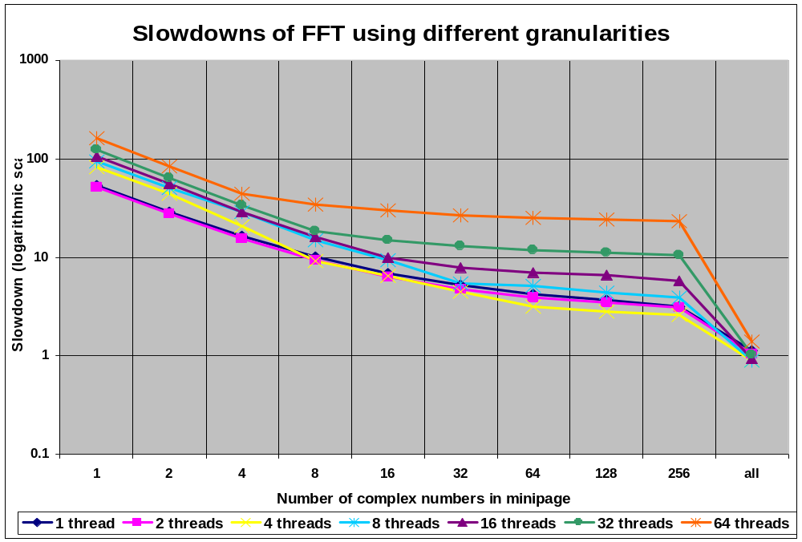
Detection Granularity

Slide 47
Example of Instrumentation
  void func( Type* ptr, Type& ref, int num ) {
  for ( int i = 0; i < num; i++ ) {
  ptr->smartPointer()->data +=
  ref.smartReference().data;
  ptr++;
  }
  Type* ptr2 = new(20, 2) Type[20];
  memset( ptr2->write(20*sizeof(Type)), 0, 20*sizeof(Type) );
  ptr = &ref;
  ptr2[0].smartReference() = *ptr->smartPointer();
  ptr->member_func( );
  }
Currently, the desired value is specified by user
through source code annotation
No
Change!!!
Notes:
SmartPointer gets “this” implicitly.
In this way it implicitly gets the pointer to the object on which the function is called.
This is also true for smartReference (and in general for all class member functions).
The “no change” rows contain instructions that do not need to dereference as they do not access shared data.
Note member_func() is instrumented and so its invocation need not.

Slide 48
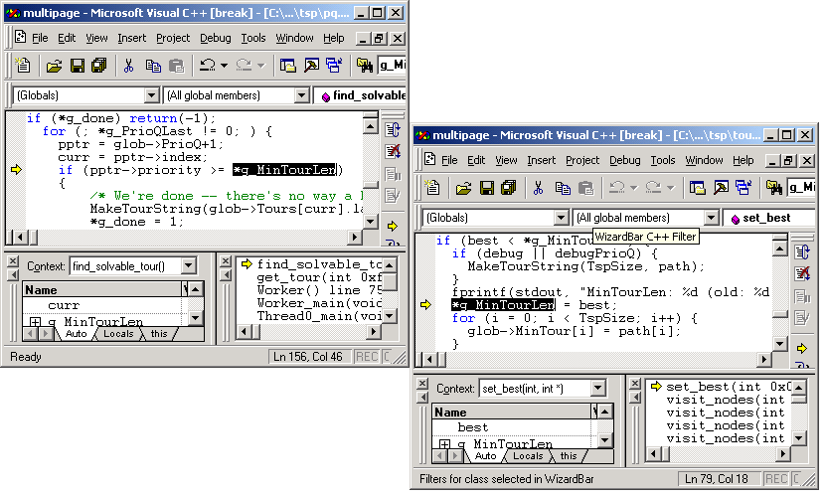
Reporting Races in MultiRace

Slide 49
Benchmark Specifications (2 threads)
 | Input Set | Shared Memory | # Mini-pages | # Write/ Read Faults | # Time- frames | Time in sec (NO DR)
FFT | 2⁸*2⁸ | 3MB | 4 | 9/10 | 20 | 0.054
IS | 2²³ numbers 2¹⁵ values | 128KB | 3 | 60/90 | 98 | 10.68
LU | 1024*1024 matrix, block size 32*32 | 8MB | 5 | 127/186 | 138 | 2.72
SOR | 1024*2048 matrices, 50 iterations | 8MB | 2 | 202/200 | 206 | 3.24
TSP | 19 cities, recursion level 12 | 1MB | 9 | 2792/ 3826 | 678 | 13.28
WATER | 512 molecules, 15 steps | 500KB | 3 | 15438/ 15720 | 15636 | 9.55

Slide 50
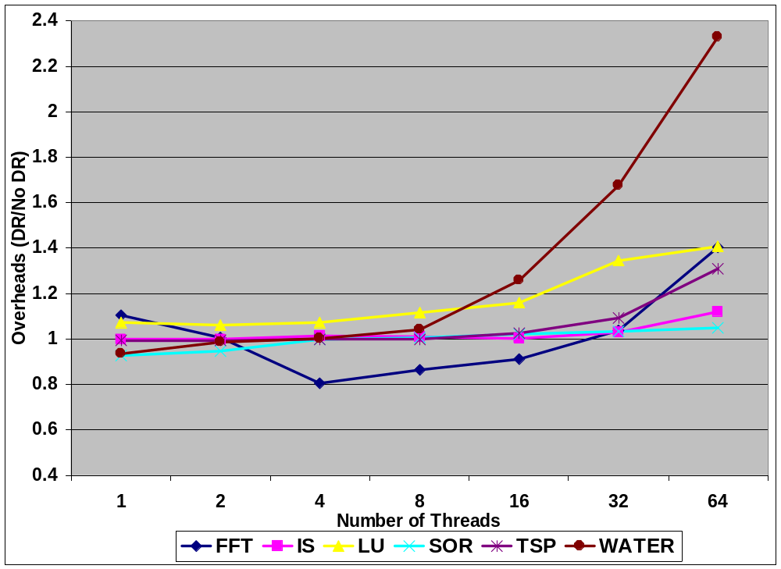
Djit Benchmark Overheads
(4-way IBM Netfinity server, 550MHz, Win-NT)

Slide 51
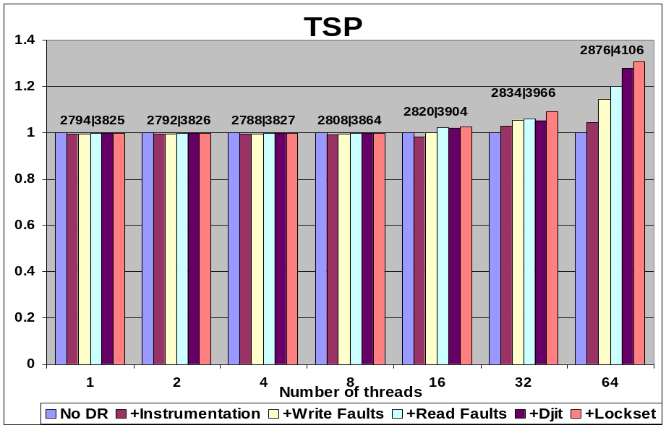
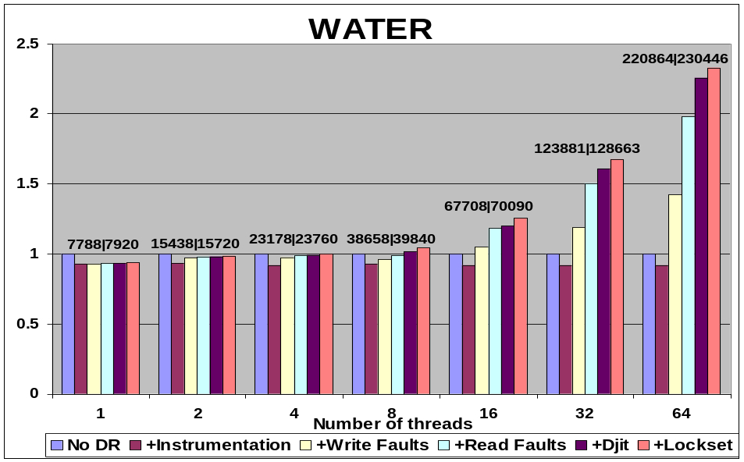
Overhead Breakdown
Numbers above bars are # write/read faults.
Most of the overhead come from page faults.
Overhead due to detection algorithms is small.

Slide 52

The End

